Slide 1

Our Team
CREDIT CARD APPROVAL SYSTEM
Tejas Ajayrao Padole (Team Leader)
Ashish Falke
PROJECT DOMAIN
Finance and Risk Analytics

Slide 2

Problem Statement
Variable Categorization
While issuing the credit card bank face a lot of challenges such as weather a person will pay be able to pay of the debt on time or not.
So it become very important for the bank to check authenticity and history of a person before issuing the credit card.
The objective of this capstone project is to predict whether the customer who will be issued the credit card is at risk or not.
There are 10 numerical columns and 9 categorical columns
Numerical Columns:
Categorical Columns:
['CODE_GENDER', 'FLAG_OWN_CAR', 'FLAG_OWN_REALTY', 'CNT_CHILDREN', 'NAME_EDUCATION_TYPE', 'NAME_FAMILY_STATUS', 'NAME_HOUSING_TYPE', 'JOB', 'STATUS’]
['ID','AMT_INCOME_TOTAL', 'DAYS_BIRTH', 'DAYS_EMPLOYED', 'FLAG_MOBIL', 'FLAG_ WORK_PHONE', 'FLAG_PHONE','FLAG_EMAIL', 'BEGIN_MONTHS’, 'TARGET'] ]
Pre-Processing Data Analysis (count of missing/ null values, redundant columns, etc.)
The dataset has no missing values in all of the columns.

Slide 3
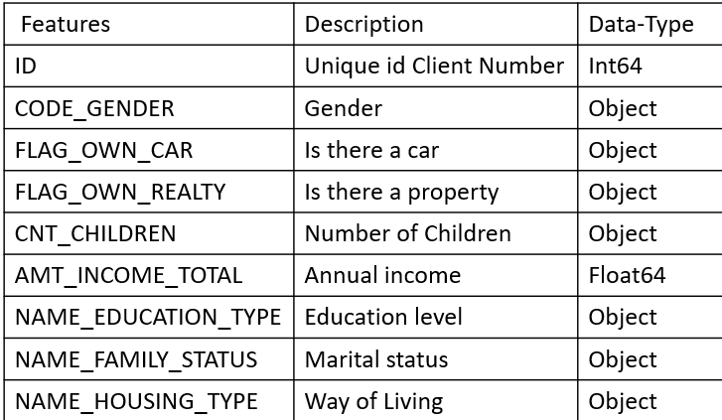
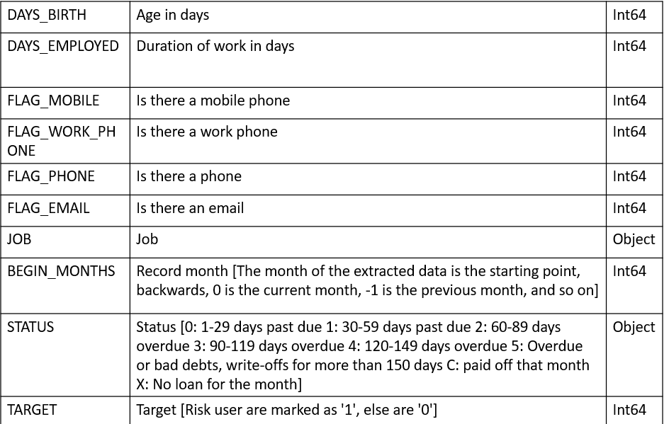
The dataset contains application records of the credit card users of a bank. The dataset has 537667 records and 19 attributes. The attribute/feature/column names are given below:
Dataset And Domain:
Data Dictionary:

Slide 4
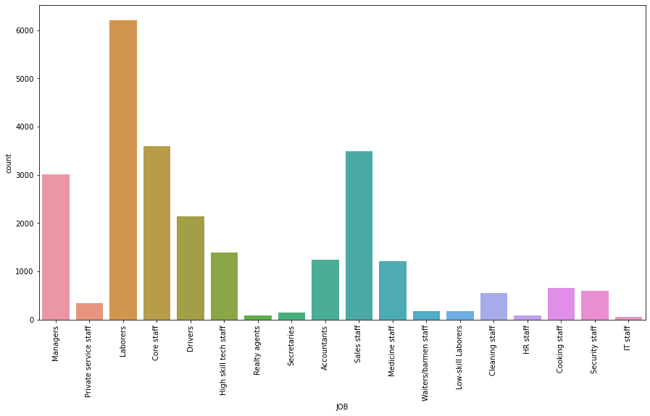
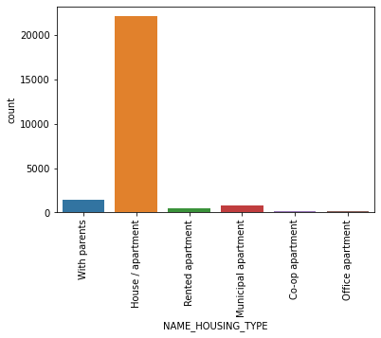
Married Status Attribute:
Work Phone Attribute, Phone Attribute and Email Attribute:
No_of children_Attribute:
Job Attribute:
Name_Housing_Type Attribute:

Slide 5
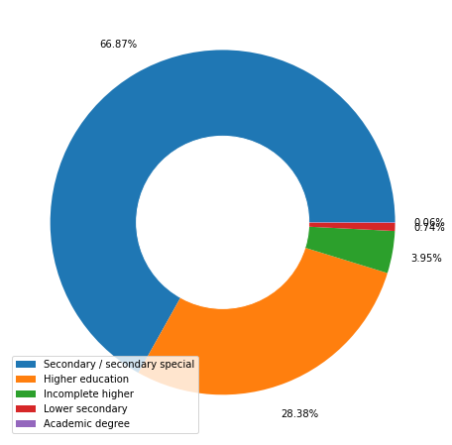
Univariate Analysis:
Education_Details Attribute:
Gender Attribute:
The above plot shows that from the data, 62% records are of female gender and 38% are of male gender.
Home Ownership Attribute
65% of the records have their own home, while 35% don't own a home.
Car Ownership Attribute
From the above plot, we can see that 42% of the records have their own car and 58% don’t own a car.

Slide 6
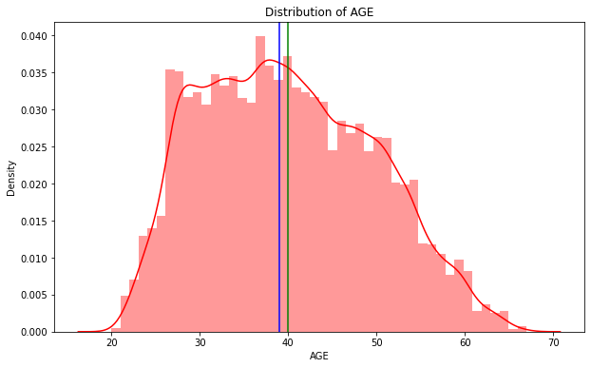
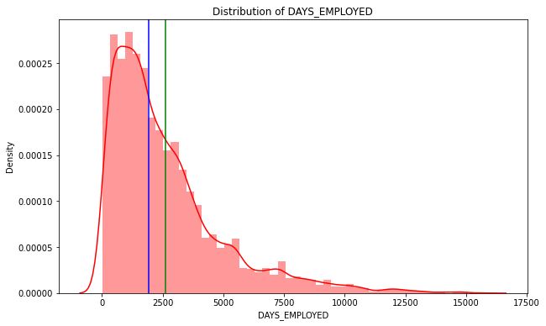
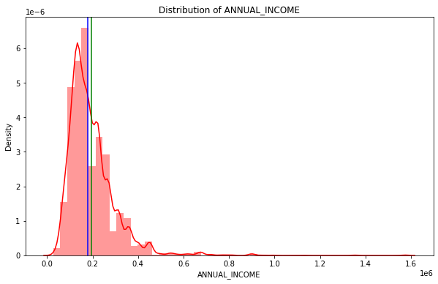
Analysis of Numerical Variables:
From the below plots, each of the numerical variables are analyzed individually.
Distribution of AGE
Distribution of DAYS_EMPLOYED
Distribution of ANNUAL_INCOME

Slide 7
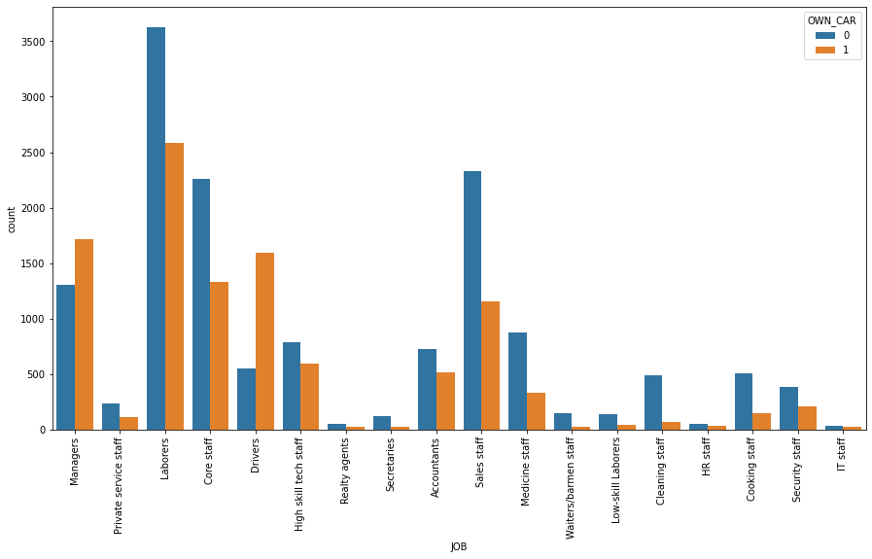
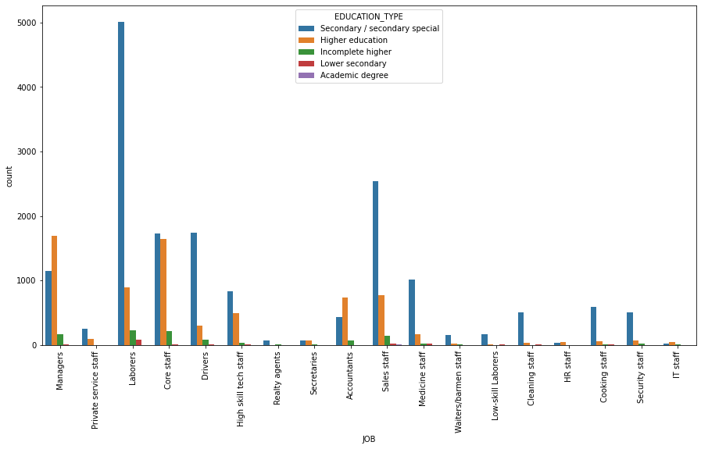
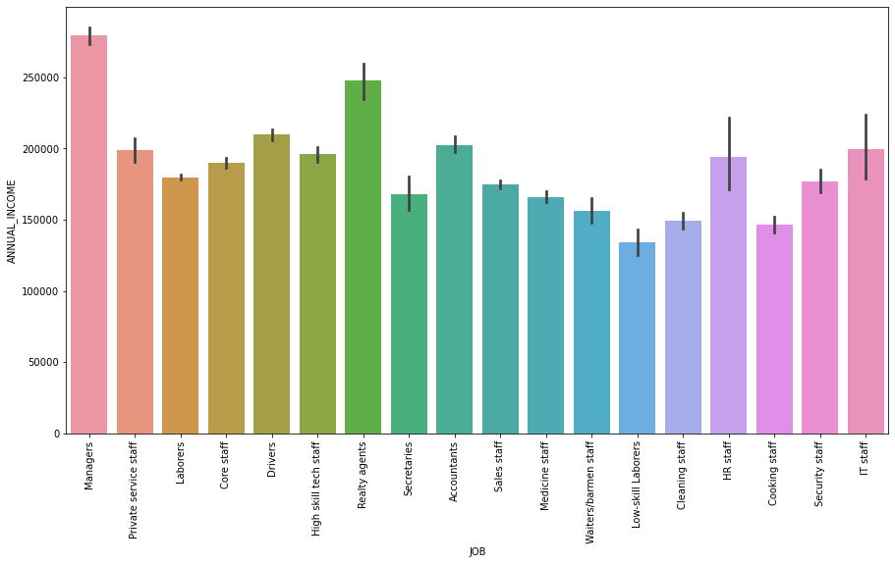
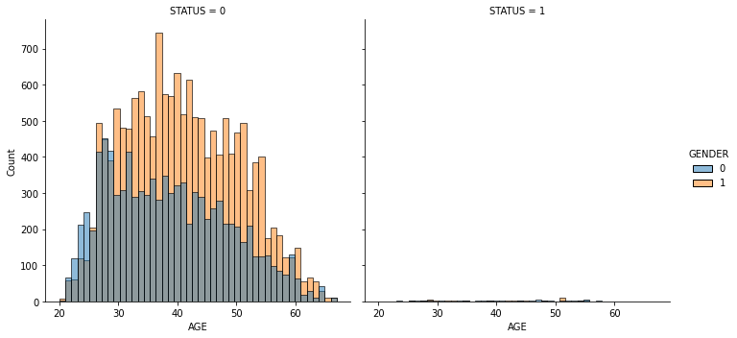
Bivariate Analysis
Analysis of Job Attribute and Own_Car
Analysis of Job Attribute and Education_Type:
Analysis of Job Attribute and Annual_Income
Analysis Of Age And Status With Age Distributed Into Gender Categories:

Slide 8
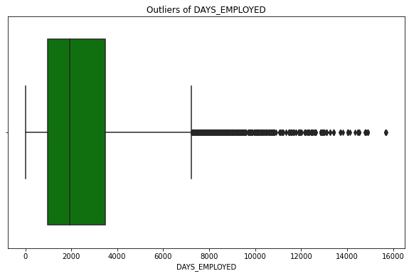
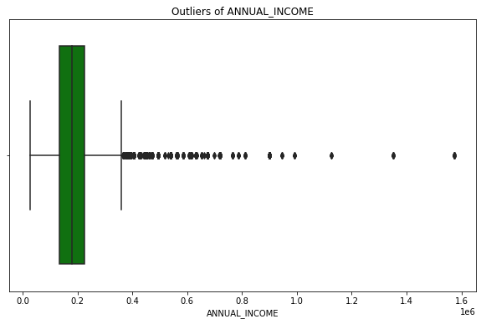
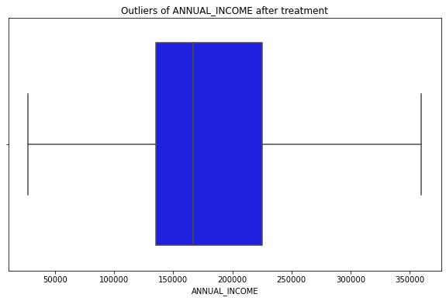
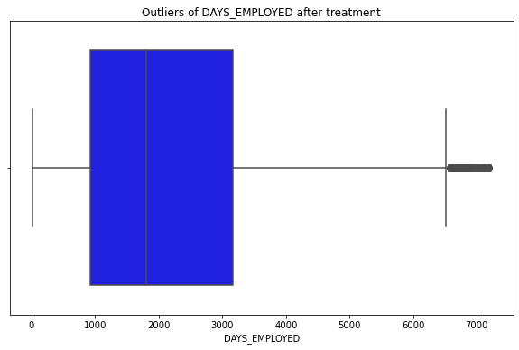
Outlier Analysis
Outliers in Days_Employed
Outliers in
Annual_Income:
After Outlier Treatment Days_Employed
After Outlier Treatment Annual_Income:

Slide 9
Feature Engineering
Missing Values Treatment
The dataset has no missing values, so missing values treatment is not required.
Following columns were encoded :
Application Details
Own Car and Own Home
Education Status
Gender
Family Status
Housing Type
Encoding
Scaling of Variables
Following variables were scaled using standard scalar:
1. Annual Income
2. Days Employed

Slide 10
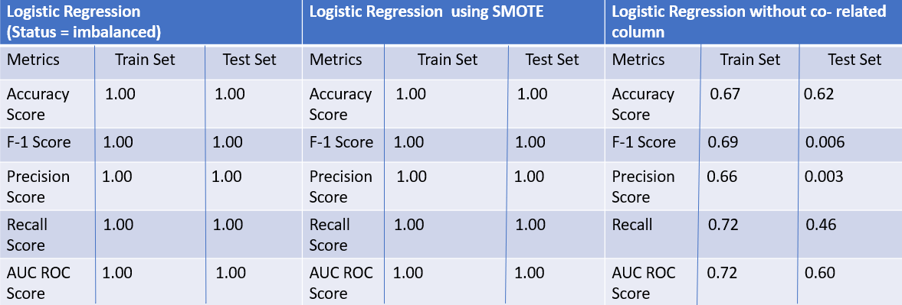
MODEL BUILDING
Models With Logistic Regression as Base Model

Slide 11
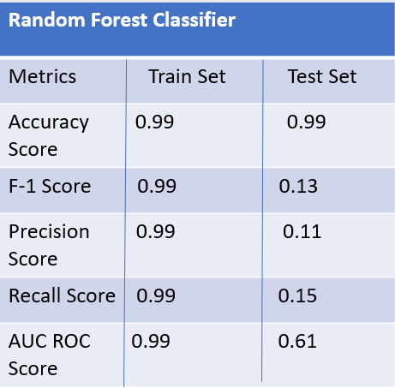
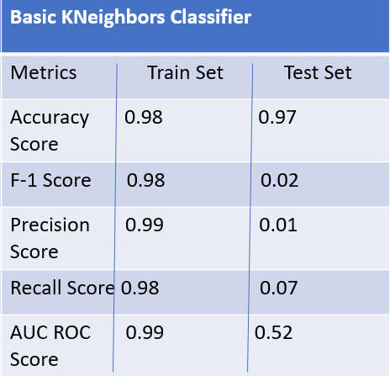
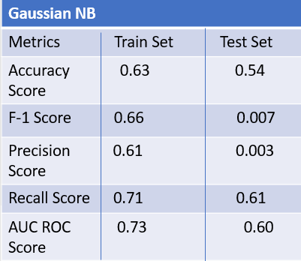
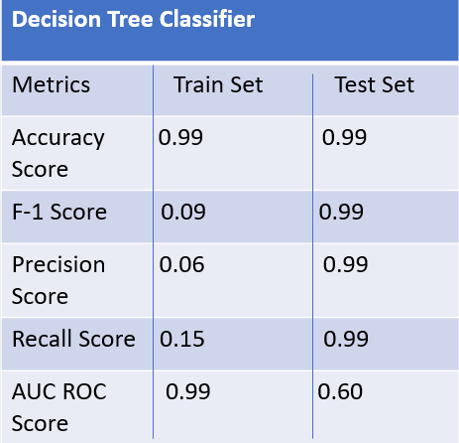
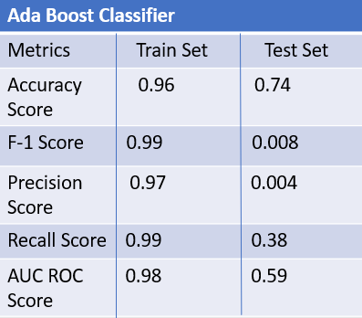
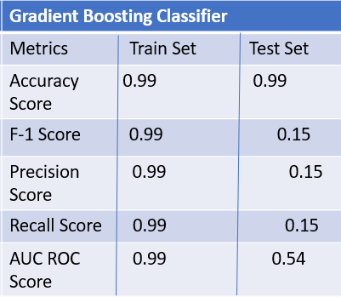
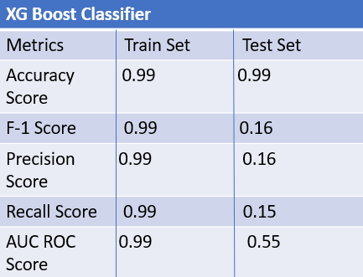
MODELS WITH BALANCED DATA WITHOUT TUNING

Slide 12
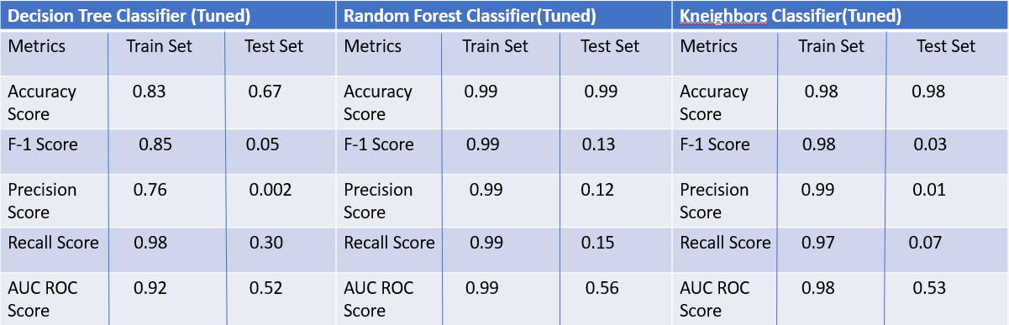
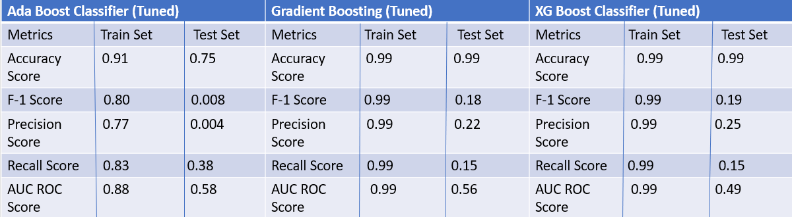
MODELS WITH BALANCED DATA WITH TUNING

Slide 13
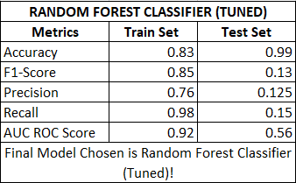
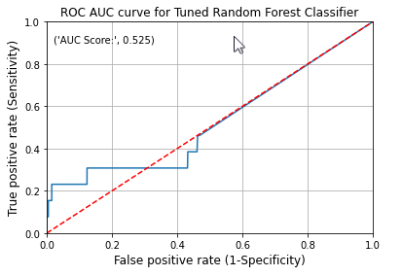

SELECTED MODEL
ROC AUC curve for Random Forest Tuned
 | Actual 0 | Actual 1
Predicted 0 | 4703 | 11
Predicted 1 | 14 | 2

Slide 14
Findings
Limitations/Challenges
In order to get approval of the credit card for the candidate, following characteristics were found out:
Annual Income of the candidate plays a major part in approval making decision, generally higher income gets approval easily.
Days of employment help in to know the stability of work balance of the candidate
Age, Education too play a factor in deciding the approval of credit card
No of dependents of the candidate, his married status also play a minor role in approval process
If a candidate own home and own car, it increase the chance of approval as it shows the candidate have a good financial background
Very high data imbalance
Different Imputation methods
Redundant Features
Hyper parameter tuning

Slide 15
Business Recommendations
Based on this project's analysis, income, age, family member headcount, and employment length are the three most predictive features in determining whether an applicant will be approved for a credit card.
Key business finding being that people with the highest income and who have at least one partner, are more likely to be approved for a credit card.
People whose income is very less, who do not have a partner and have more than 2 dependents with them have a slight chance of not getting rejected for credit card.
Another business recommendation for the banks is to increase the number of inputs about the applicant so that it would result in getting bias-variance tradeoff to get optimal results from the model.

Slide 16
Thank You

